Slide 1
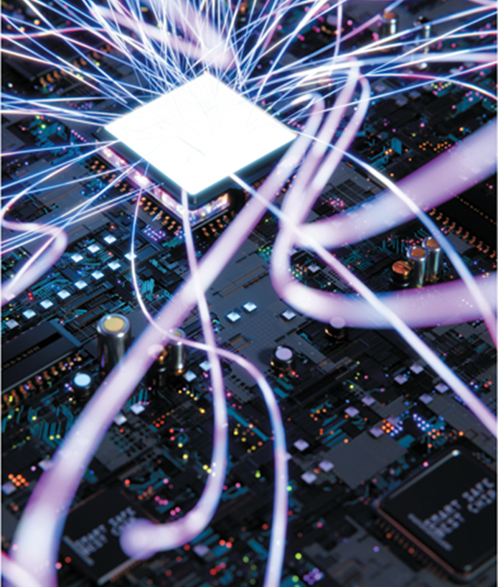
Chapter 5
System Unit
Computing Essentials 2023
O’Leary
Notes:
The chapter introduces you to how to protect your computer and data today and prepare you for tomorrow including types of computers, computer components, peripherals, and upgrades.

Slide 2
Learning Objectives
Differentiate between the five basic types of system units.
Describe system boards, including sockets, slots, and bus lines.
Recognize different microprocessors, including microprocessor chips and specialty processors.
Compare different types of computer memory, including RAM, ROM, and flash memory.
Explain expansion slots and cards.
Describe bus lines, bus widths, and expansion buses.
Describe ports, including standard and specialized ports.
Identify power supplies for desktop, laptop, tablet, and mobile devices.
Explain how a computer can represent numbers and encode characters electronically.
Notes:
Review the Learning Objectives with students to help them understand what they need to get from the chapter.

Slide 3
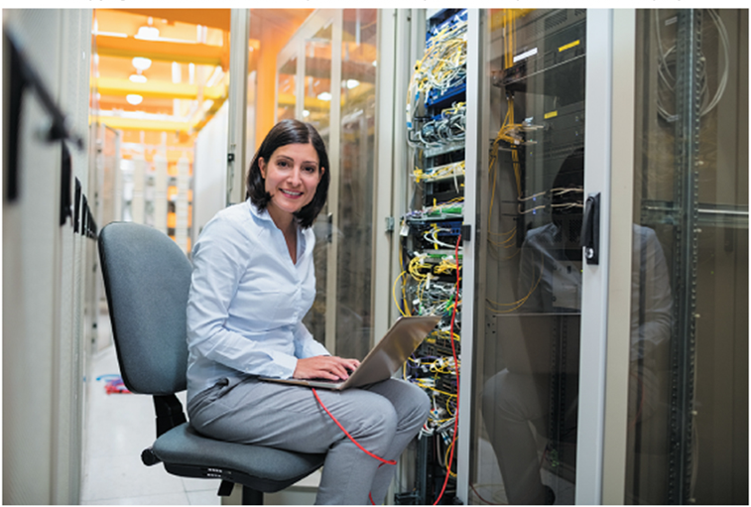
Introduction
Speed, capacity, and flexibility determine the power of personal computers.
Knowledge of a computer’s power allows you to make good buying decisions and to determine if your current system will run new applications.
Competent end users need to understand the functionality of the basic components of the system unit.
Wave Break Media/Shutterstock
Notes:
Inform students about the Computer Buyer’s Guide at the end of the book which provides additional information on purchasing a computer.

Slide 4
System Unit Basics
Container that houses most of the electronic components that make up a computer system.
System Chassis.
Personal Computer - Most widely used type of computer.
Five most common types.
Smartphones.
Tablets.
Laptops.
Desktops.
Wearable Computers.
Notes:
System unit (key term) is also referred to as the system chassis(Key Term) – container that houses most of the electronic components that make up a computer system
Personal computer (key term) – most widely used type of computer
All computers have a system unit
Smartphones (key term) or Hand-held computer systems (key term) – entire computer system is contained in the device. Most popular mobile device
Tablet (Key Term) or tablet computer – flat screen and typically do not have a keyboard.
Operating system controls their operations
Laptop (key term) – contains electronic components, secondary devices, and input devices – often called notebook computers (Key Term)
Two-in-one laptops (key term) – can act as a tablet or a laptop
Gaming (key term) – high-end graphics and fast processors
Ultrabook or Ultraportables (key term) or mini notebook (key term) are very portable laptops.
Lighter, thinner, longer battery life
Desktop (key term) – contains electronic components and selected secondary storage.
System units are placed in tower units (key term) or tower computers (key term)
Wearables (key term) contain embedded computers
Smartwatches and Activity Trackers

Slide 5
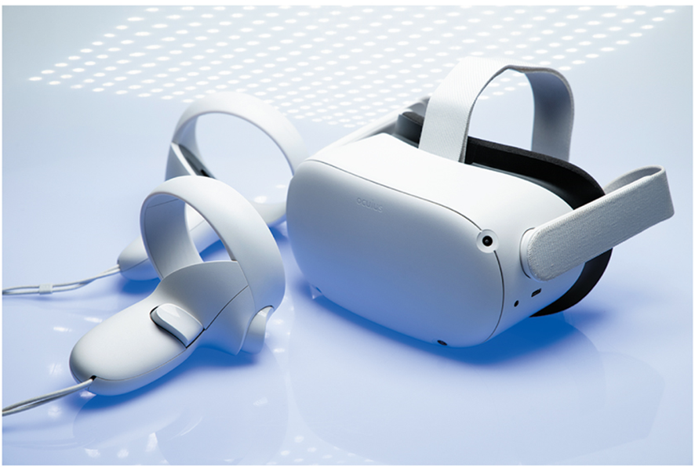
Making IT Work for You ~ Gaming
Mobile gaming.
Console gaming.
P C gaming.
Kazuo Horiike/Jiji Press/Newscom
Notes:
Gaming has many different platforms and determining which one best fits your style will allow you to get the most out of your gaming experience.

Slide 6
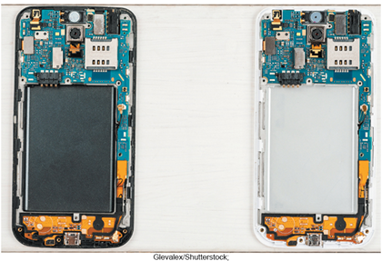
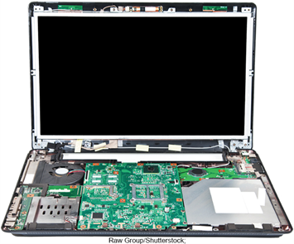
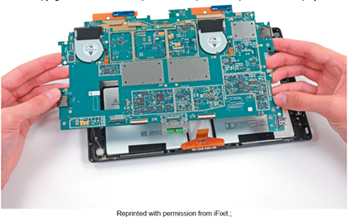
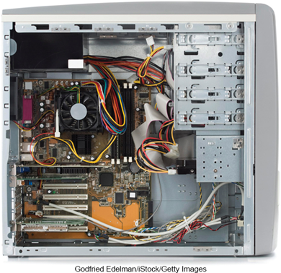
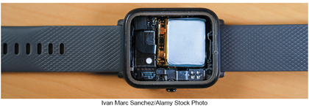
Components
Although all devices come in many shapes and sizes they have similarities such as.
System boards.
Microprocessors.
Memory.
Cell phone: Source: Reprinted with permission from iFixit; Tablet: Source: Reprinted with permission from iFixit; Wearable: Source: Bill Detwiler/ TechRepublic. Used with permission of TechRepublic.com Copyright©2019. All rights reserved; Laptop: Source: Bill Detwiler/TechRepublic. Used with permission of TechRepublic.com Copyright©2019. All rights reserved; Desktop: Godfried Edelman/iStock/ Getty Images
Notes:
Components appear different among devices, but share similarities such as system boards, microprocessors and memory.

Slide 7
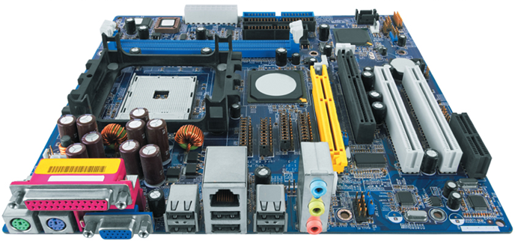
System Board
System board, also known as the main board or motherboard, controls communication for the entire computer system.
All components and devices connect to the system board.
Data path and traffic monitor.
Allows various components to communication efficiently with one another.
Branston/Future/REX/Shutterstock
Notes:
System board (key term) or mainboard (key term) or motherboard (key term) – controls communication for the entire computer system
All devices and components connect to the system board
Acts as a data path and traffic monitor that allows the components to communicate with each other.

Slide 8
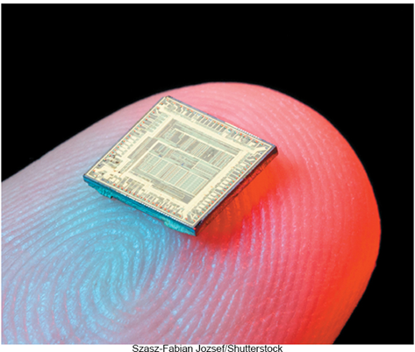
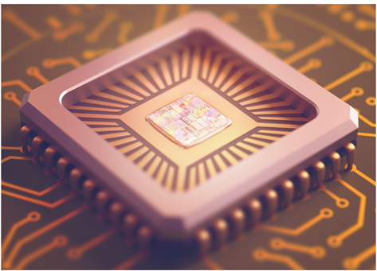
Sockets and Chips
The system board contains a variety of electronic components .
Sockets – the connection point for chips.
Chips.
Tiny circuit boards etched onto squares of silicon.
Also called silicon chip, semiconductor, or integrated circuit.
Mounted on chip carriers.
Lucidio Studio Inc/Photographer’sChoice/Getty Images; Geostock/Getty Images
Notes:
Sockets (key term) – connection point for chips
Chips (key term) contain numerous circuits etched on a small wafer of layers of silicon and other materials
Chips are mounted on chip carriers (Key Term)
Chips are also referred to as a silicon chip (Key Term), semiconductor (Key Term), or integrated circuit (Key Term)

Slide 9
Slots and Bus Lines
Additional system board components:
Slots.
Provide a connection point for specialized cards or circuit boards.
Provide expansion capabilities for the computer.
Bus lines.
Connecting lines that provide pathways to support communication among electronic components.
Notes:
Slots (key term) – connection point for specialized cards or circuit board
Provides expansion capability
Bus lines (key term) –connecting lines that provide pathways that support communication

Slide 10
Microprocessor
Central Processing Unit (C P U) or Processor.
Contained on a single chip call a microprocessor.
Brains of the computer.
Two Basic Components of the C P U.
Control unit.
Tells the computer system how to carry out a program’s instruction.
Arithmetic-logic unit (A L U).
Performs arithmetic and logical operations.
Notes:
Central Processing Unit (CPU) (key term) or processor is located on the microprocessor (key term) chip and has two components - the control unit and the arithmetic-logic unit
Control Unit (key term)
Program instructions
Directs flow between memory and Arithmetic-Logic Unit
Directs flow between CPU and I/O devices
Arithmetic-Logic Unit – ALU (key term)
Two types of operations
Arithmetic operation (Key Term) such as addition, subtraction, multiplication and division
Logical operation (Key Term) comparisons such as equal to, less than and greater than

Slide 11
Microprocessor Speed
Chip capacities are expressed in word size.
Word is the number of bits that can be processed at one time: 16, 32 or 64.
Clock Speed.
Processing speed or the number of times the C P U fetches and processes data or instructions in a second.
Unit | Speed
Microsecond | Millionth of a second
Nanosecond | Billionth of a second
Picosecond | Trillionth of a second
Femtosecond | Quadrillionth of a second
Notes:
A word (Key Term) is the number of bits that can be accessed at one time by the CPU
8 bits group together to form a byte
32 bit word computer can access 4 bytes at a time
64 bit word computer can access 8 bytes at a time
Clock speed (key term) – number of times the CPU can fetch and process data and instructions in a second
Older computers measured in millionth of a second – microsecond
Newer computers measured in billionth of a second – nanosecond
Super computers measured in picoseconds

Slide 12
Multicore Chips
Multicore Processors.
Two or more separate and independent C P Us within a system unit.
Quad-core supports 4 core processes.
Parallel Processing.
Computer’s ability to divided tasks into parts that can be distributed across each core.
Windows 11 and macOS Big Sur support parallel processing.
Processor | Manufacturer
Ryzen 5000 | A M D
M1 | Apple
Alder Lake | Intel
Notes:
Multicore processors (key term) – allow a single computer to run two or more operations at the same time
Example: quad-core processor could have one core computing a complex Excel spreadsheet while the other is running a multimedia presentation while the third is running Word and the fourth is running Access.
Parallel Processing (key term) – dividing tasks into parts that can be distributed across each core

Slide 13
Specialty Processors
Coprocessors.
Designed to improve specific computing operations.
Graphics Processing Unit (G P U) / Graphics coprocessors.
Designed to handle a variety of specialized tasks.
3D images.
Encrypting data.
Standard features in gaming computers.
Notes:
Specialty processors are designed to handle special functions
Coprocessor (key term) chips designed to improve specific computing operations
Graphics coprocessor (key term), Graphics Processing Unit
Displaying 3-D images and encrypting data
Cars may have more than 100 specialty processors now.

Slide 14
Memory
Holding area for data, instructions, and information.
Contained on chips connected to the system board.
Three well-known types of memory chips:
RAM.
Random Access Memory.
ROM.
Read Only Memory.
Flash Memory.
Notes:
Memory (key term) – holding area for data, instructions and information
RAM (Random-access memory) (Key Term) - chips hold the program (sequence of instructions) and data that the CPU is presently processing
ROM (Read-only memory) (Key Term) - chips have information stored in them by the manufacturer. Unlike RAM chips, ROM chips are not volatile and cannot be changed by the user.
Flash (Key Term) - offers a combination of the features of RAM and ROM. Like RAM, it can be updated to store new information. Like ROM, it does not lose that information when power to the computer system is turned off.

Slide 15
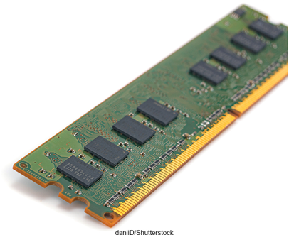
RAM 1
Random Access Memory (RAM) chips hold programs and data that the C P U is presently processing.
Volatile or temporary – contents are lost when computer is powered off.
Cache memory – temporary, high-speed holding area between the memory and C P U.
Additional RAM can be added using an expansion module called a D I M M (Dual in-line memory module).
Simon Belcher/Alamy Stock Photo
Notes:
Temporarily holds data and programs being processed by the CPU
Volatile - when power shuts off, contents of RAM are emptied
Exception - flash RAM can retain data when power disrupted, used in high end portable computers
Cache memory (key term) – improves processing by acting as a temporary high-speed holding area between the memory and CPU
Area in RAM set aside to store information frequently accessed
DIMM (dual in-line memory module) (key term) – additional RAM
RAM is also referred to as temporary or volatile storage
It is a good idea to save your work to a secondary storage device. which uses permanent, or nonvolatile, storage

Slide 16
RAM 2
Virtual Memory.
Dividing a program between memory and storage enabling the system to run very large programs.
Memory is expressed in bytes.
Unit | Capacity
Megabyte (MB) | 1 million bytes
Gigabyte (GB) | 1 billion bytes
Terabyte (TB) | 1 trillion bytes
Petabyte (PB) | 1 quadrillion bytes
Notes:
Virtual memory (key term) – dividing a program between memory and storage enabling the system to run very large programs

Slide 17
ROM
Read-only memory (ROM).
Information stored by the manufacturer.
Non-volatile and cannot be changed.
C P U can read, or retrieve data and programs in ROM but the computer cannot change ROM.
Contain special instructions.
Start the computer.
Access memory.
Handle keyboard input.
Notes:
ROM is used for special instructions such as starting the computer, accessing memory and handling keyboard input.
Many ROM chips have been replaced by flash memory for many applications

Slide 18
Flash Memory
Flash memory combines the features of:
RAM, it can be updated.
ROM, it is non-volatile.
Contains startup information.
BIOS (basic input/output system).
Amount of RAM.
Type of keyboard, mouse, and secondary storage devices connected.
Many ROM chips are being replaced by flash memory!
Notes:
Used for a wide-range of applications
Used to store start-up instructions; BIOS (basic input/output system) (key term)
Flash memory – can retain data even if the power is disrupted
Most expensive type of RAM
Used for digital telephones, digital video cameras, and portable computers

Slide 19
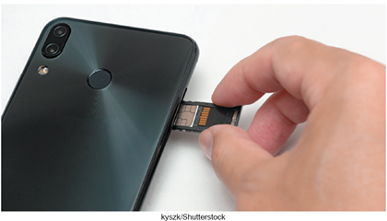
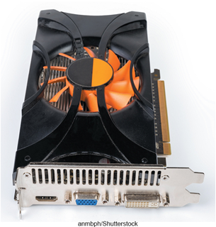
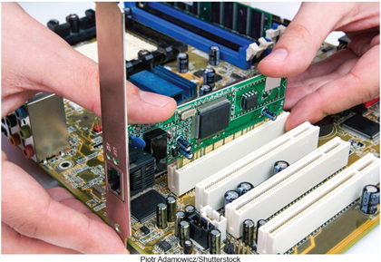
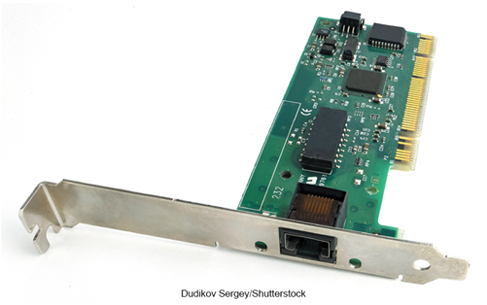
Expansion Slots and Cards
Expands your system’s capabilities.
S D cards.
Expansion cards for phones, tablets, and laptops.
Graphics cards for high quality 3D graphics.
Network interface cards (N I C) connect devices to networks via cables.
Wireless network cards connect devices to networks without cables.
Vitalii Petrushenko/Shutterstock; Piotr Adamowicz/Shutterstock; antpkr/Shutterstock; CobraCZ/Shutterstock
Notes:
Expansion slots (key term) used to insert expansion cards (key term)
SD Cards (key term) – expansion cards for laptops, tablets and smartphones.
Graphics cards (Key term) - provides high quality of 3-D graphics
Network Interface Cards (Key Term) (NICs or Network Adapter Cards) – attaches a user to a network
Wireless network cards (key term) – allow computers to be connected to a network without cables

Slide 20
Bus Lines/Bus
Connect parts of the C P U to each other and various other components on the system board.
Pathway for bits representing data and instructions.
Bus width.
Number of bits that can travel simultaneously down a bus.
Architecture and design are tied to the speed and power for the computer.
Two basic categories of buses.
System bus – connects C P U to memory.
Expansion bus – connects C P U to other components.
Notes:
Bus lines (key term) - provide data pathways that connect various system components
A bus line is also called a bus (Key Term)
Bus width (key term) is the number of bits that can travel at once
It is a pathway for bits representing data and instructions
A bus is similar to a multilane highway.
Every computer has two basic categories of buses
System bus (key term) – connects the CPU to memory on the system board
Expansion bus (key term) – connects the CPU other components and to slots on the system board

Slide 21
Expansion Buses
Principle types:
Universal Serial Bus (U S B).
Connects external U S B devices onto the U S B bus.
FireWire.
Primarily used to connect audio and video equipment to the system board.
P C I Express (P C Ie).
Single dedicated path for each connected device.
Notes:
Universal Serial Bus (USB) (key term) – most widely used
FireWire buses (key term) – similar to USB but more specialized.
used primarily to connect audio and video equipment to the system board
PCI Express (PCIe) (key term)– widely used in many of today’s most powerful computers; provides a single dedicated path for each connected device (unlike other buses which share a single bus line or path with several devices.)

Slide 22
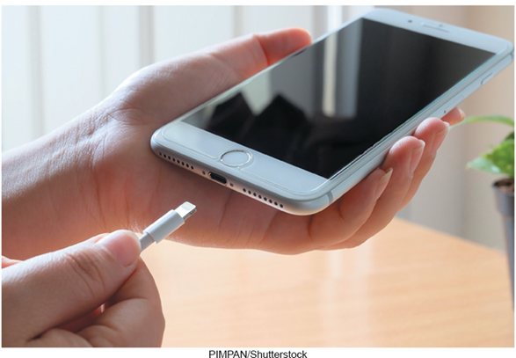
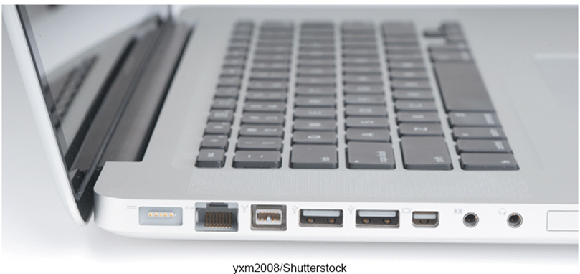
Ports
Socket for connecting external devices to the system unit.
Some ports connect directly to the system board, others connect to cards inserted into slots on the system board.
Two Types.
Standard Ports.
Specialized Ports.
oleschwander/Shutterstock
Notes:
Ports are connecting sockets on the outside of a system unit
Ports are often standard features of computer systems and others are more specialized
Two types of ports:
Standardized
Specialized

Slide 23
Standard Ports
U S B.
Keyboards, mice, printers, storage devices.
Variations of U S B ports include: U S B-A, U S B-B, U S B-C, and Thunderbolt 3 (a high speed version of U S B-C).
H D M I – High Definition Multimedia Interface.
High definition video and audio.
Ethernet.
High speed networking.
Notes:
Port (key term) – socket for external devices
USB (universal serial bus) (key term) - connects several devices to the system unit. Variations include: USB-A, USB-B, USB-C, and Thunderbolt 3, which is a high speed USB-C port
HDMI (key term) – High-Definition Multimedia Interface – provides high-definition video and audio
Ethernet (key term) – standard for networking, allows you to connect multiple computers for sharing files, or to a DSL or cable modem for internet access

Slide 24
Specialized Ports
DisplayPort (D P).
Connects to large monitors.
Popular on gaming computers.
D V I (Digital Video Interface).
Connect digital monitors to computer.
Can only send video signals, not audio.
FireWire.
High-speed connections to FireWire devices such as camcorders and storage devices.
Notes:
DisplayPort (DP) (key term) – Provides a connection for a large monitor
DVI (key term) – connections to digital monitors
FireWire ports (key term) connects camcorders and storage devices

Slide 25
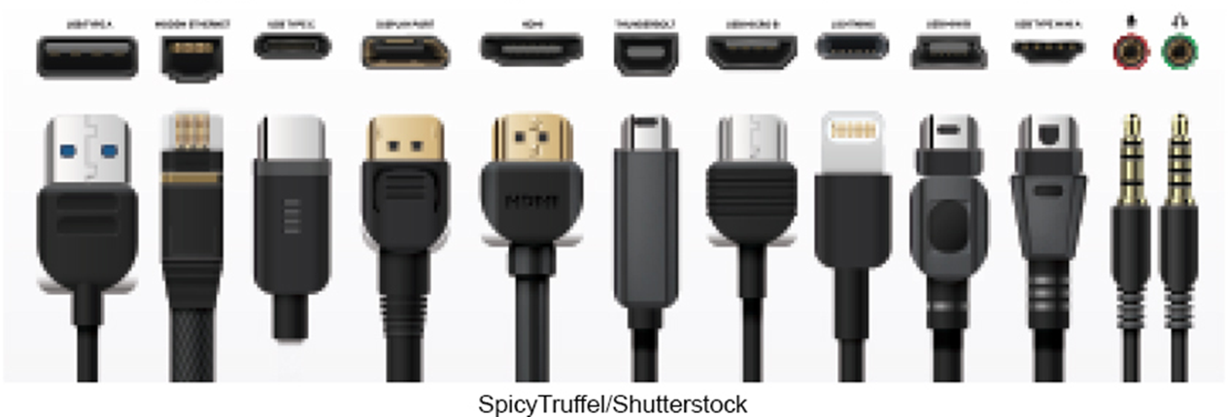
Cables
Used to connect external devices to the system unit via the ports.
One end of the cable is attached to the device and the other end has a connector that is attached to a matching connector on the port.
oleschwander/Shutterstock
Notes:
Cables (key term) physical connections for devices to the system unit via ports

Slide 26
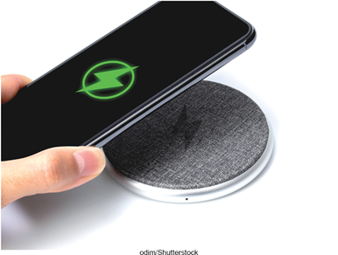
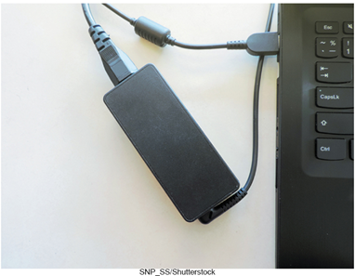
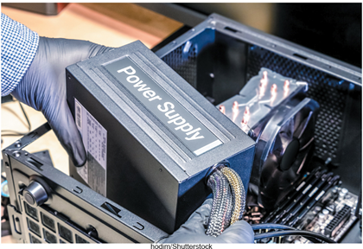
Power Supply
Computers require direct current (D C) power converting alternating current (A C) from wall outlets or batteries.
Desktop computers have a power supply unit in the system unit.
Laptops use A C adapters in the system unit.
Tablets and mobile devices use internal A C adapters.
Smartphones can use wireless charging platforms.
Akkraraj kangrang/Shutterstock; SNP_SS/Shutterstock; Microstocker13/Shutterstock
Notes:
Direct current (DC) powers computers
Desktop computers have a power supply unit (key term) unit located within the system unit
Laptop computers use AC adapters (key term) that are located outside the system unit
Tablets and mobile devices use AC adapters
Many smartphones use a wireless charging platforms (key term)

Slide 27
Electronic Data and Instructions
Digital electronic signals.
Recognized by computers.
Analog signals.
Continuous signal.
Created by voices.
Conversion must take place from analog to digital before processing can occur.
Notes:
Digital signals (key terms) – electronic signals only recognized by computers
Analog signals (key terms) – created by voice

Slide 28
Numeric Representation
Two-state binary system consists of only two digits called bits.
On = 1; negative charge.
Off = 0; no charge.
Decimal | Binary | Hex
00 | 00000000 | 00
01 | 00000001 | 01
02 | 00000010 | 02
03 | 00000011 | 03
04 | 00000100 | 04
05 | 00000101 | 05
06 | 00000110 | 06
07 | 00000111 | 07
08 | 00001000 | 08
09 | 00001001 | 09
10 | 00001010 | 0A
11 | 00001011 | 0B
12 | 00001100 | 0C
13 | 00001101 | 0D
14 | 00001110 | 0E
15 | 00001111 | 0F
Byte = 8 bits grouped together.
Hexadecimal system.
Uses 16 digits to represent binary numbers.
(0, 1, 2, 3, 4, 5, 6, 7, 8, 9, A, B, C, D, E, F)
Figure
Notes:
Binary System (key term) – consists of only two digits, 0 and 1. Each 0 or 1 is called a bit (key term) which is short for binary digit
8 bits grouped together is a byte (key term)
Binary numbers are difficult to read so they are represented in a hexadecimal system (key term) or hex using 16 digits to represent binary numbers

Slide 29
Character Encoding
ASCII.
American Standard Code for Information Interchange.
Used by personal computers.
EBCDIC.
Extended Binary coded Decimal Interchange Code.
Used by mainframe computers.
Unicode.
New encoding due to explosion of the Internet.
Can be written in U T F-16 or U T F-8.
Recognized by virtually all computer systems.
Notes:
Character encoding standards (key term) assign a unique sequence of bits to each character
Historically used ASCII (key term) for microcomputers and EBCDIC (Extended Binary coded Decimal Interchange Code) (key term) for mainframes
Unicode (key term) is a new character encoding using 16 bits with UTF-16 and as small as 8 bits with UTF-8, which is the more efficient standard
Uses a variable number of bits to represent each character.

Slide 30
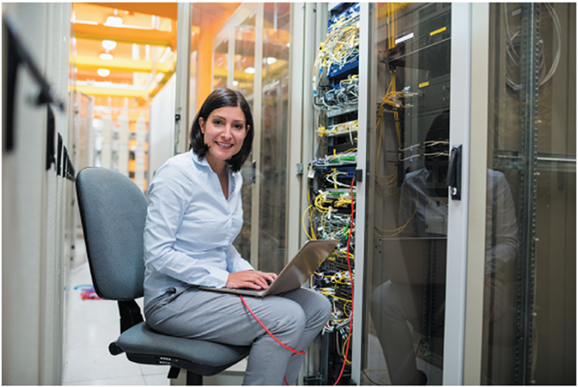
Careers in I T
Computer technicians repair and install computer components and systems.
Employers look for:
Certification or associate’s degree in computer repair.
Communication skills.
Continued education is required.
Computer technicians can expect to earn an annual salary from approximately $27,000 to $58,000.
Wave Break Media/Shutterstock
Notes:
Opportunities for advancement typically come in the form of work on more advanced computer systems
Some computer technicians move into customer service positions or go into sales

Slide 31
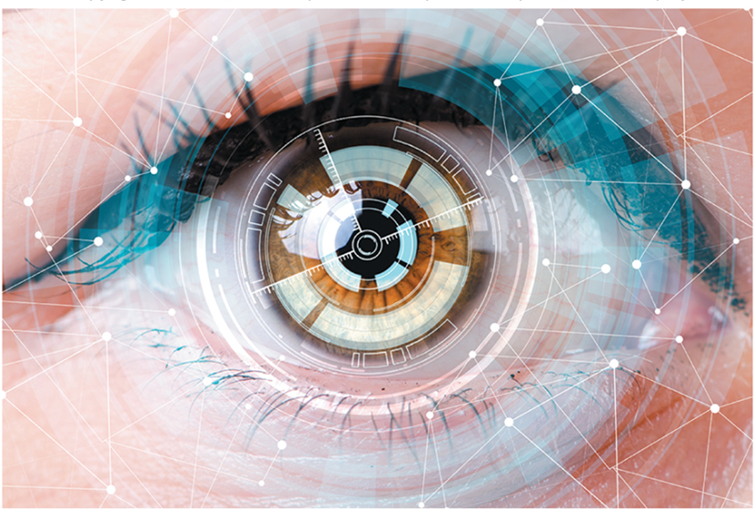
A Look to the Future
Brain-Computer Interfaces.
May soon be able to image all the brain’s electrical impulses.
Victoria Shapiro/Shutterstock
Notes:
Review Page 124

Slide 32
Open Ended Questions
Describe the five most common types of personal computers.
Describe system boards including sockets, chips, chip carriers, slots, and bus lines.
Discuss microprocessor components, chips, and specialty processors.
Define computer memory, including RAM, ROM, and flash memory.
Define expansion slots, cards (including graphics cards), network interface cards, wireless network cards, and S D cards.
Describe bus lines, bus width, system bus, and expansion bus.
Define ports including standard and specialized ports. Give examples of each.
Describe power supply including power supply units and A C adapters.
Discuss electronic data and instructions.
Notes:
Have students turn to the end of Chapter 5 in their textbooks to view the same “Open-Ended” questions/statements

Slide 33
End of Main Content
© McGraw Hill LLC. All rights reserved. No reproduction or distribution without the prior written consent of McGraw Hill LLC.

